Slide 1
Using REDCap alongside an existing Electronic Data Capture (EDC) system
Fitting in with existing processes and comparing functionality between systems
Presented by
Rich Simmonds - Data Management/Information Systems Officer, Clinical Trials Research Unit, ScHARR

Slide 2
Fitting in with existing processes
How REDCap can be used in an established health research environment – did we need to change our Standard Operating Procedures (SOPs) and processes, and how can we show REDCap is fit for purpose?

Slide 3
The existing environment
ScHARR - CTRU - UKCRC Registered Clinical Trials Unit
‘providing high quality support in running clinical trials in line with international regulatory standards, from the planning stages right through to analysis and reporting.’
Data management
‘Using Prospect, our in house web-based electronic data capture system, we will work with you to design a bespoke database to allow you to meet your data collection and management needs.’

Slide 4
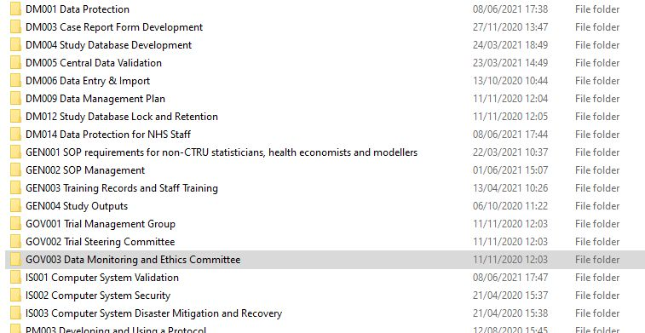
Our current SOPs

Slide 5
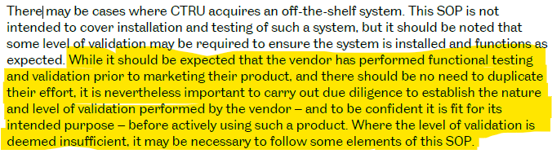
Example SOP (Computer System Validation)
Exisiting SOP made allowances for off-the-shelf systems but highlighted potential need for in-house validation

Slide 6
Existing Processes
Shared Processes
Fitting in with study development
Checking for references to ‘Prospect’ – standardising where possible, creating parallel process if not
New processes
Server set-up
Validating updates
Using the system

Slide 7
Comparing functionality between systems
What does the experience with our existing system tell us about REDCap?

Slide 8
Similarities
Secure login
Randomisation
Customised user permissions
Secure in-house data storage
Custom designed data collection forms

Slide 9
Differences
REDCap
System is free
In-house customisation
In-house maintained
Externally led core development
User roles
Terminology – DAGs, DQ
Dynamic reporting
Prospect
System is paid for
External customisation
Externally maintained
In-house led core development
Users defined individually
Terminology – Sites, DV
Static reporting

Slide 10
What extra functionality does REDCap add
Third party customisation
Worldwide development
Used across the UK
Familiarity

Slide 11
What is stopping some of REDCaps functionality being used?
Trust
Validation
Time
Expertise
COST

Slide 12
Lessons and thoughts
What using REDCap and comparing it to our current system has taught me about it

Slide 13
What REDCap is and isn’t
Licence and software is free
Has the potential for GDPR and regulation compliance
Can be customised with self built or third party add-ons
Platform for running multiple studies
Set-up, maintenance, and validation costs staff time
Depends on local set-up and validation for compliance
Customisations are additions to the software so would need validation
Single study management software

Slide 14
REDCap’s ethos – personal responsibility
Community responsibility
If you want to use REDCap it is up to you to make it compliant
If you want to customise/improve REDCap it is up to you to drive/champion this change
User responsibility
Example: Users can enter data in the order they want – there is no form dependency

Slide 15
Limiting costs & going forward
Split/share responsibilities for system
Server set-up and maintenance
REDCap instances
University/UK/World wide add-on development
Third party customisation development through student projects
Open to students for data management in projects

